Slide 1



Capstone Project-1 (Exploratory Data Analysis)
Play Store App Review Analysis
https://colab.research.google.com/jayu071
Play Store App Review Analysis_datadigger | Kaggle
https://github.com/jayu071/Playstore_DateDigger

Slide 2
Team Member
Team DATA DIGGERS
1. SARTHAK ARORA | sarthak1611@gmail.com
2. JAY NANDASANA | nandasanajay@gmail.com
3. MADHAVI MALI | madhvimali1996@gmail.com
4. PRANJALI TETE | pranjalitele@gmail.com
5. ARSHI WANI | arshiwani3@gmail.com

Slide 3
Content
Introduction
Problem Statement
Dataset Description
Play store App Data
User Reviews Data
Data Processing Flowchart
Import Libraries
Data Loading
Null values Imputation / Data Cleaning
Data Segregation
Exploratory & Visualization Analysis
Conclusion

Slide 4

Introduction
The Play Store apps data has enormous potential to drive app-making businesses to success. Actionable insights can be drawn for developers to work on and capture the Android market
Taking into account billion of Android users worldwide, mining this data has the potential to reveal user behaviours and trends in the whole global scope. This dataset is obtained from scraping Google Play Store.

Slide 5
Problem Statement
New app maker company is trying to identify various factors to capture android market ,so they are trying to find out the following things from the app store data:
1.Which is the best suitable Android version for new App?
2.Which are the top ‘category’ apps available in the play store?
3.What are the top ‘genre’ apps available in play store?
4.Ratings flow of the Apps
5.Paid and Free App ratio
6.People age group ratio, who are connected with play store
7.Apps vs their updated year ratio
8.Age group and its response against apps
9.Category wise free and paid apps
10.Age wise preferred category

Slide 6
Dataset Description Two different datasets provided for analysis: 1.Play Store Data.csv App : Categorical, the app name. Category : Categorical, category the app belongs to. Rating : Numerical, range from 0.0 to 5.0,Rating has received from the users. Reviews : Numerical, the number of reviews that the app received. Size : Numerical, the size of the app. The suffix M - megabytes, K - kilobytes. Installs : Numerical, describes the number of installs. Type : Categorical, a label that indicates whether the app is free or paid. Price : Numerical, the price value for the paid apps. Content Rating : Categorical, a categorical rating that indicates the age group for user. Genre : Categorical, list of genres to which the app belongs. Last Update : Date Format, the date at which the app was last updated. Current Version : Version of the app as specified by the developers. Android Version : The Android OS the app is compatible with.

Slide 7
App : the app name. Translated_Review : the review text in English. Sentiment : the sentiment of the review, positive, neutral, or negative. Sentiment_Polarity : the sentiment in numerical form, ranging from -1.00 to 1.00. Sentiment_Subjectivity : a measure of the expression of opinions, evaluations, feelings, and speculations.
Dataset Description
2.User Reviews.csv

Slide 8
Data Processing Flowchart
Import Libraries
DataFrame Loading
Drop Duplicate Entry
Remove Visual Impurities
Find Unique, Null Count and Data type
Data Filtering
Segregate
Numerical, Categorical
Data Visualization
Final Summery
Marge DataFrames for More data visualization

Slide 9




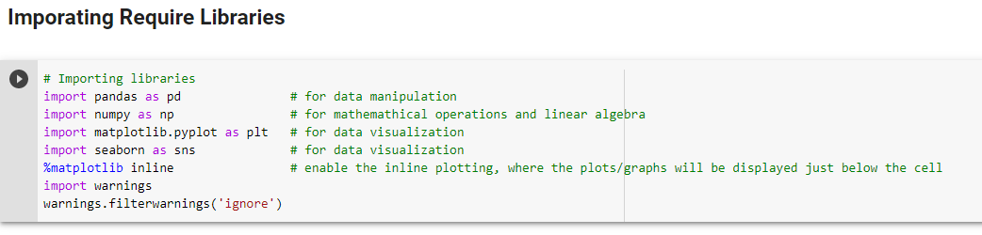
Import Libraries
library is a collection of related modules. It contains bundles of code that can be used repeatedly in different programs. It makes Python Programming simpler and convenient for the programmer.

Slide 10


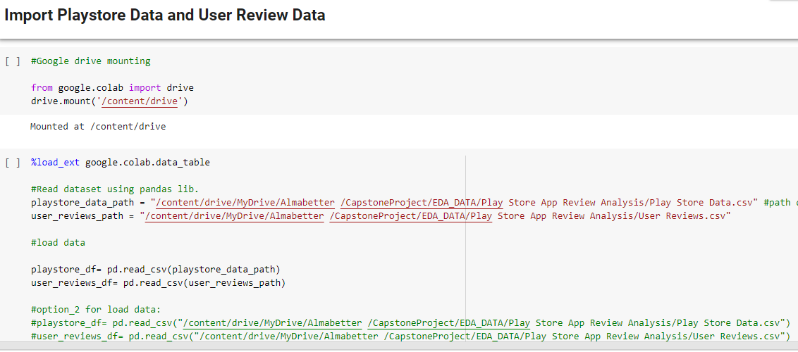
DataFrame Loading…….
1. Loading Google Drive For DATA
3. Data File Google Drive path
2. Interactive display of tabular data
4. Read dataframe using pandas liberary
5. 2nd method for load dataframe

Slide 11
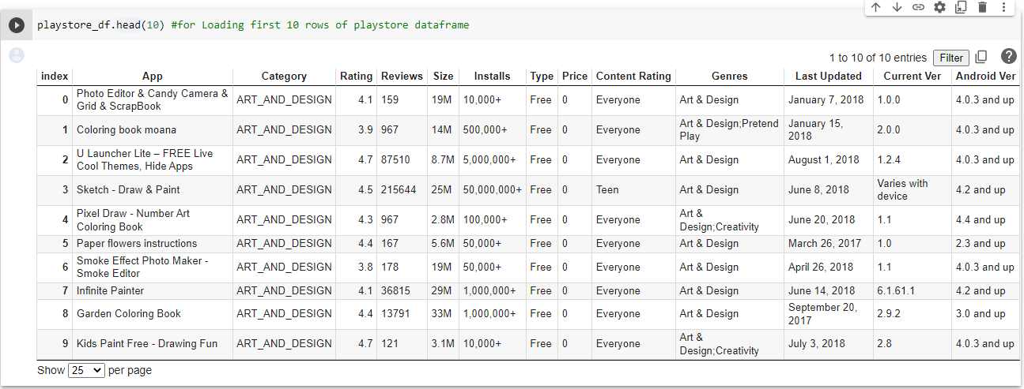
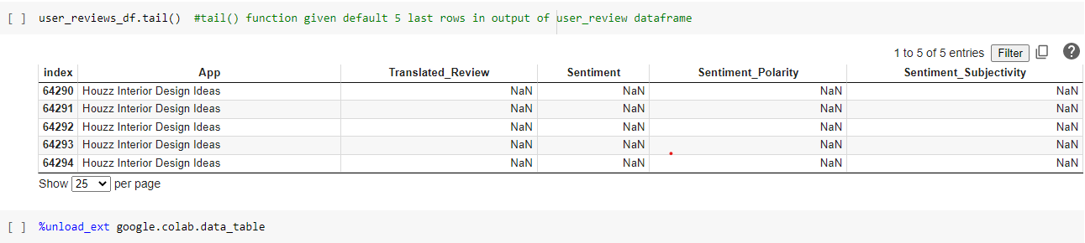
DataFrame Loading…….
1. The head () method returns a specified number of rows, string from the top
2. The tail () method returns a specified number of rows, string from the bottom. Default o/p 5 bottom rows
3. Unloading advance futures display of tabular data

Slide 12
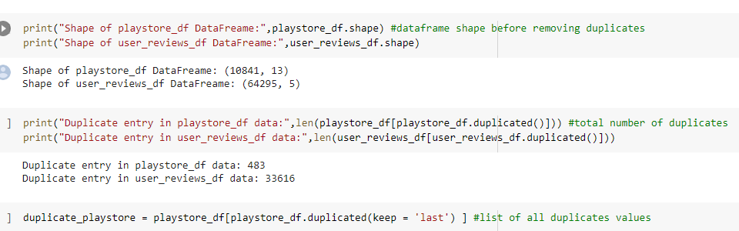
Drop Duplicate Entry
Duplicate Enter data is repeated data in dataframe,
Either multiple columns have same data or multiple rows have same data.
Repeated Entry add sums of number in final data and it miscalculates the true outcome.
df.duplicated() method is used to identify duplicates from dataframe
1. shape of data (Rows,Columns)
2. Identify duplicate entries
3. keep the last instance of a duplicate row in dataframe

Slide 13
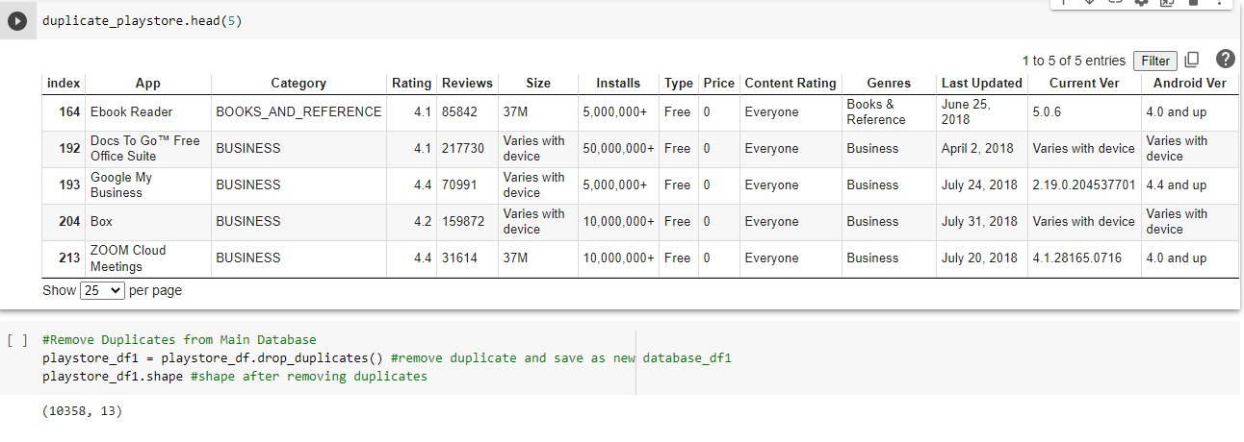
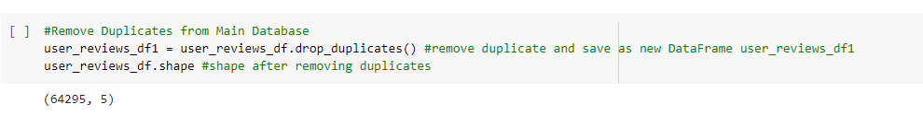
Drop Duplicate Entry
1. Print Duplicate Entry Data of playstore_df
2. Remove Duplicate Entry Data from playstore_df, print shape of data after removing duplicate entry
3. Remove Duplicate Entry Data from user_reviews_df, print shape of data after removing duplicate entry

Slide 14
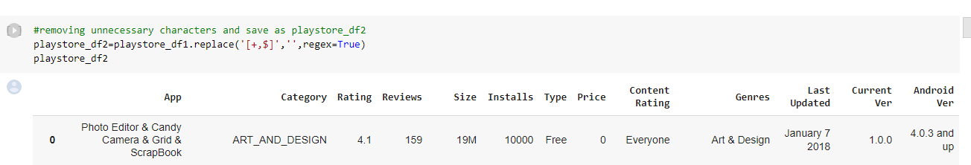
Remove Visual Impurities
Visual Impurities is like eye sight impurities in dataframe, without additional deep finding visible impurities
Like: Price Column have “$” sign and Installation column have “+” sign
1. Check dataframe and replace + and $ with blank so it works like delete.
Data after filter +

Slide 15
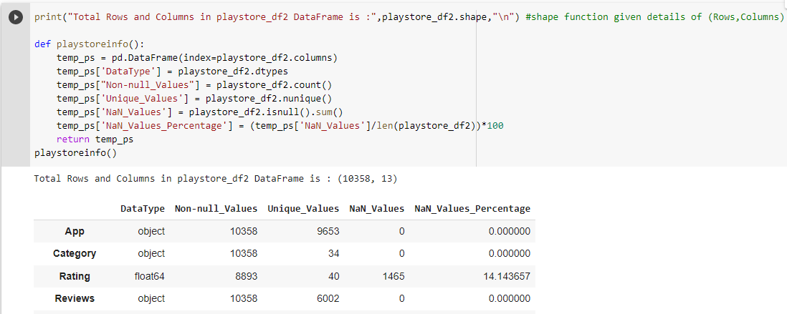
Find Unique, Null Count and Data type
For more cleaning of data we identified Unique data – Null Counts and Data type of each column
Unique Data - Unique value of particular column
Null Count - NULL means that there is no value
Nan Count - NaN mean that there is some value, although one that is perhaps not usable
Data type - Type of data like int, float64, object
Total value of App and Unique value are different, which means some App entries are repeated

Slide 16
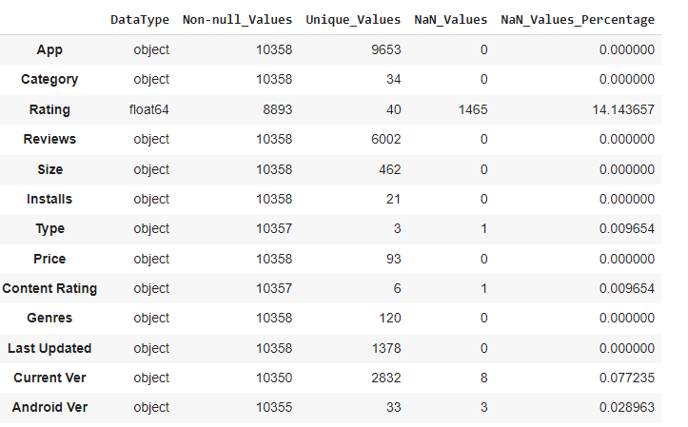
Information From Data Digging
Some columns have null values that need to be filled or filtered
Datatype are not correct for some columns like price , size, Installs and Last Update
Total count of each rows are not same so database are missing

Slide 17
Data Filtering Column by Column
All Columns have some mistakes and unreliable things that need to be filtered
No | DataType | Mistakes and Unreliable things on specific Column
1 | App | Repeated Entry in app column indicated some repeated apps are there
2 | Category | 1.9 entry in category is outliner, checked data and shifted the row
3 | Rating | Null values present, filled it with mean() or median()
4 | Reviews | Data type mistake, it’s a numerical data type
5 | Size | Converted the size into one single unit
6 | Installs | After removing +, corrected the data type to numerical
7 | Type | 1 null value present, filled it with proper data (After Crosscheck with play store fill with "Free" )
8 | Price | After removing $ sign, need to correct data type to numerical
9 | Content Rating | Did not require any operation
10 | Genres | Did not require any operation
11 | Last Updated | Data type needed to replace to Date Format : datetime64[ns]
12 | Current Ver | Did not require any operation
13 | Android Ver | Did not require any operation

Slide 18
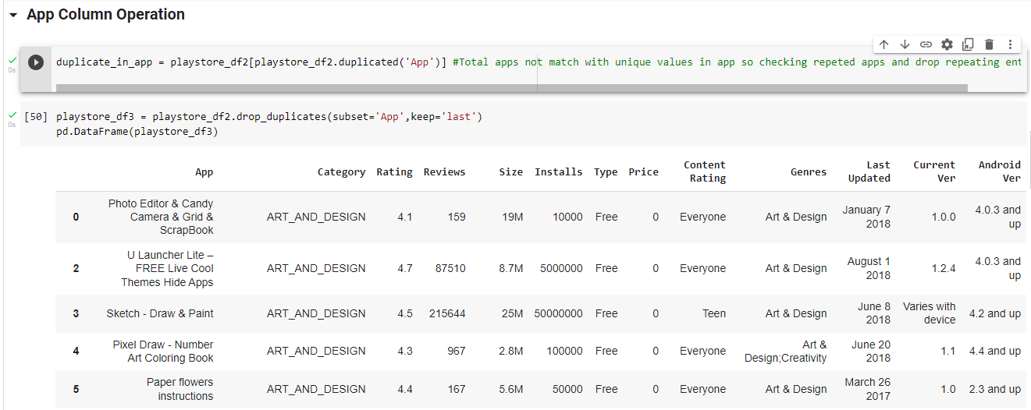
App Column Operation
1. Identify duplicate apps
2. Remove duplicates and clean data and store in playstore_df3 dataframe

Slide 19
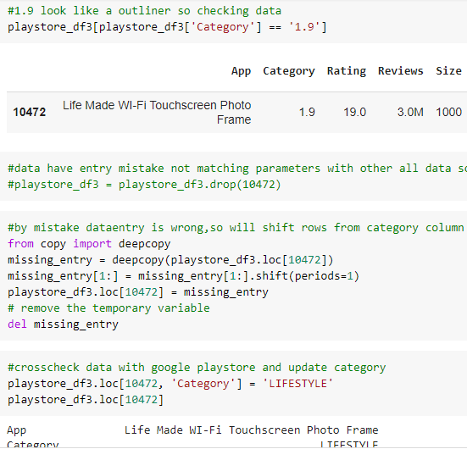
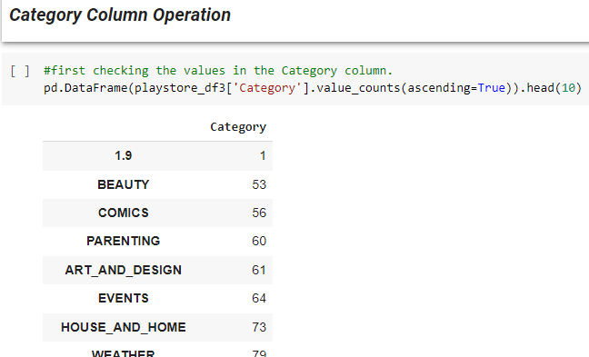
Category Column Operation
1.
2.
1.outliner
2. Find row of that data
3. Shift data
4. Replace with “LIFESTYLE” (check with playstore)

Slide 20
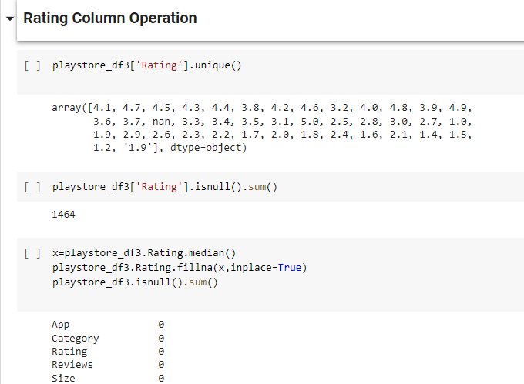
Rating Column Operation
1. Find Unique value
2. Count Null value
3. Fill with Median

Slide 21
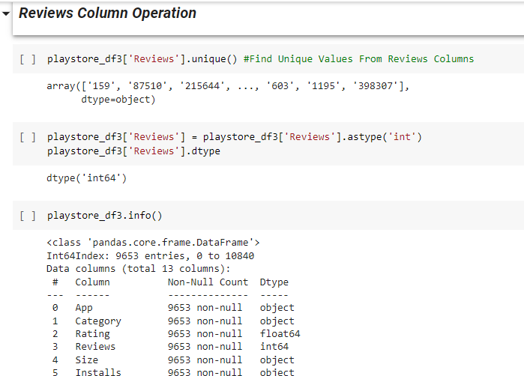
Review Column Operation
1. convert data type to “int”

Slide 22
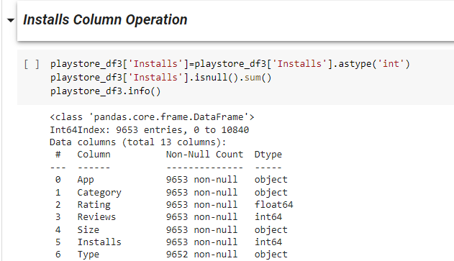
Installs Column Operation
1. convert data type to “int”

Slide 23
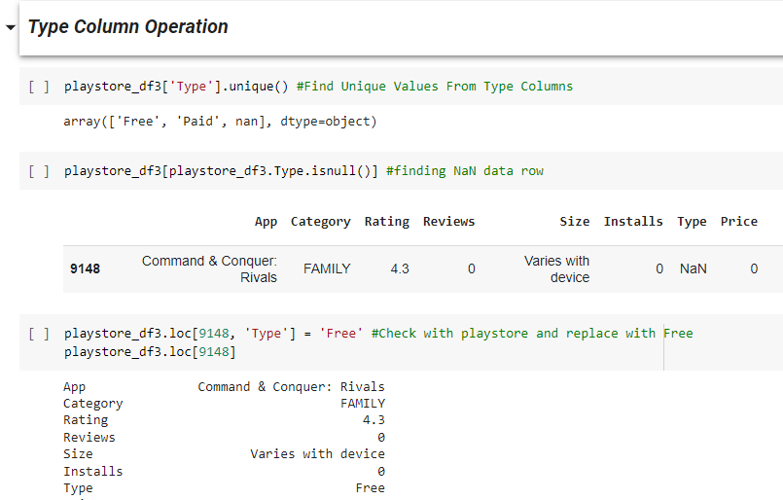
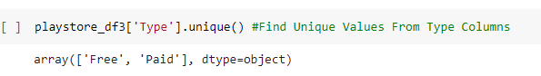
Type Column Operation
1. Find Unique values
2. Identify Row Number
3. Replace with “Free” (check with playstore)
4. Check unique values after replace value

Slide 24
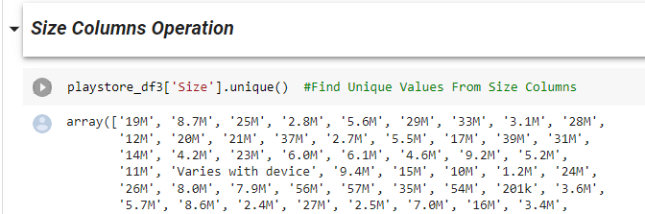
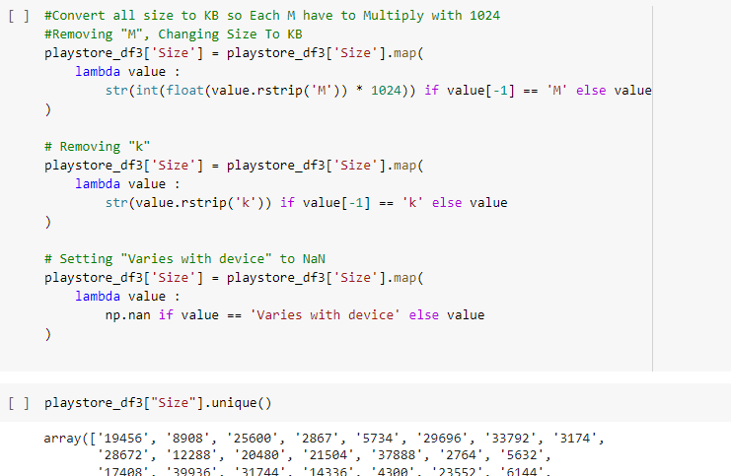
Size Column Operation
1. Value contain ‘M’, ’K’, Varies with device
2. Convert MB to KB and Remove K & M
3. Filter Data output

Slide 25
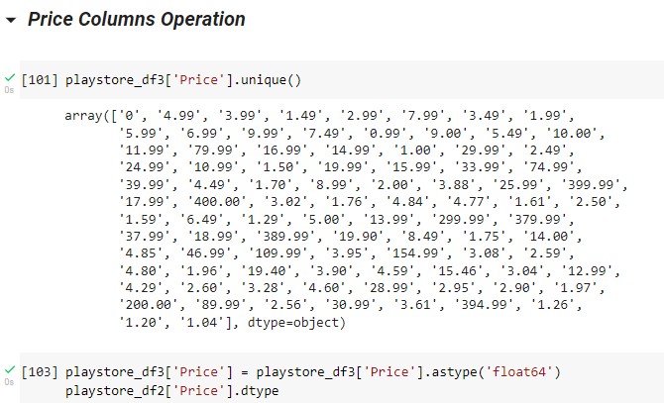
Price Column Operation

Slide 26
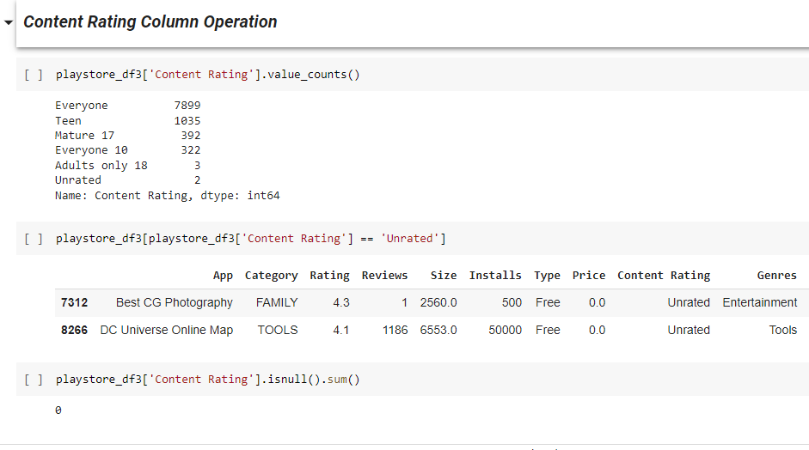
Content Rating Column Operation
1. Find value count of each type
2. Unrated apps ,also considerable for Everyone

Slide 27
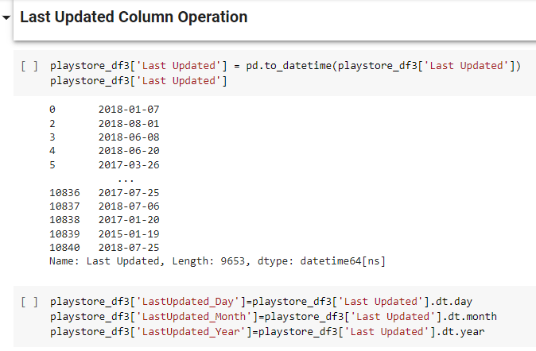
Last Update Column Operation
1.Converted to datetime datatype
2. Separate Month, Day, year and Store in new column

Slide 28
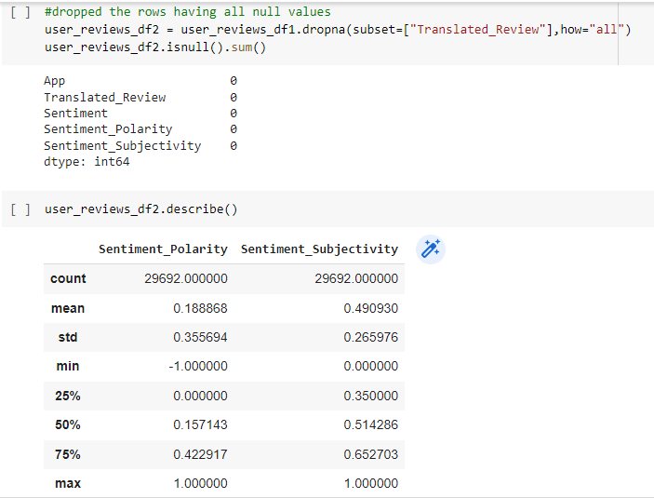
User Reviews DataFrame Operation
1. Unreviewed Columns Dropped
2. Describe Numerical Data
Sentiment_Polarity is Between -1 to 1
Sentiment_Subjectivity is Between 0 to 1

Slide 29
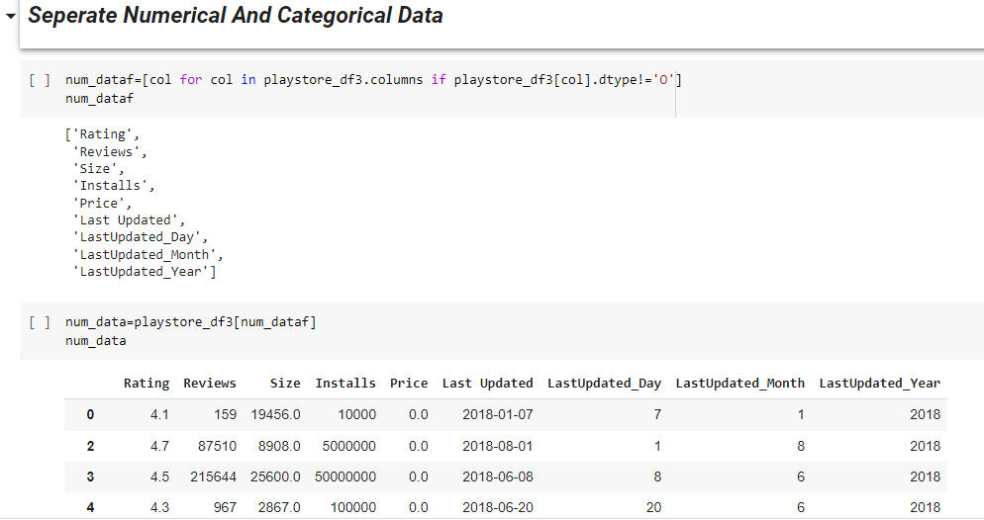
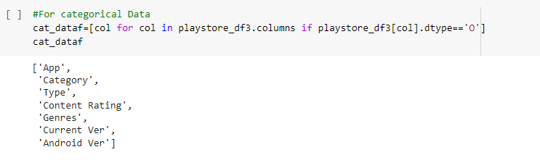
Segregate : Numerical, Categorical Variable Data
Segregate Numerical and Categorical Variable is useful to do process fast and easily plotting
1. Dtype is not an object it’s a numerical data
3. Dtype is equal to object then it’s a categorical data
2. Output of numerical data

Slide 30
Data Visualization
Correlations in Relationships: Without data visualization, it is challenging to identify the correlations between the relationship of independent variables. By making sense of those independent variables, we can make better business decisions.
Trends Over Time: While this seems like an obvious use of data visualization, it is also one of the most valuable applications. It’s impossible to make predictions without having the necessary information from the past and present. Trends over time tell us where we were and where we can potentially go.
Frequency: Closely related to trends over time is frequency. By examining the rate, or how often, customers purchase and when they buy gives us a better feel for how potential new customers might act and react to different marketing and customer acquisition strategies.
Examining the Market: Data visualization takes the information from different markets to give you insights into which audiences to focus your attention on and which ones to stay away from. We get a clearer picture of the opportunities within those markets by displaying this data on various charts and graphs.
Risk and Reward: Looking at value and risk metrics requires expertise because, without data visualization, we must interpret complicated spreadsheets and numbers. Once information is visualized, we can then pinpoint areas that may or may not require action.
Reacting to the Market: The ability to obtain information quickly and easily with data displayed clearly on a functional dashboard allows businesses to act and respond to findings swiftly and helps to avoid making mistakes.

Slide 31
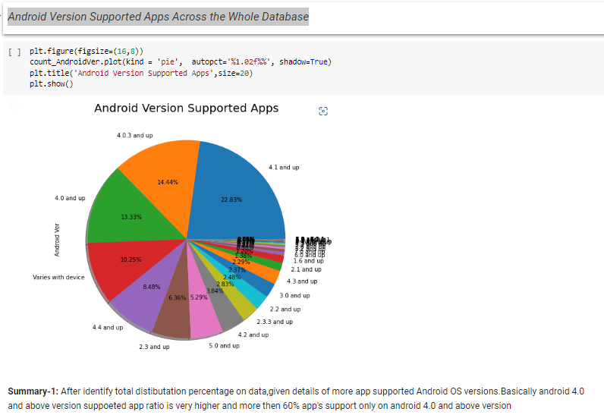
1. Most Android Ver. Supported Apps in Play store
Helpful to develop apps and minimum criteria
Find out outdate versions of apps
Identify detail about new trend version contribution

Slide 32
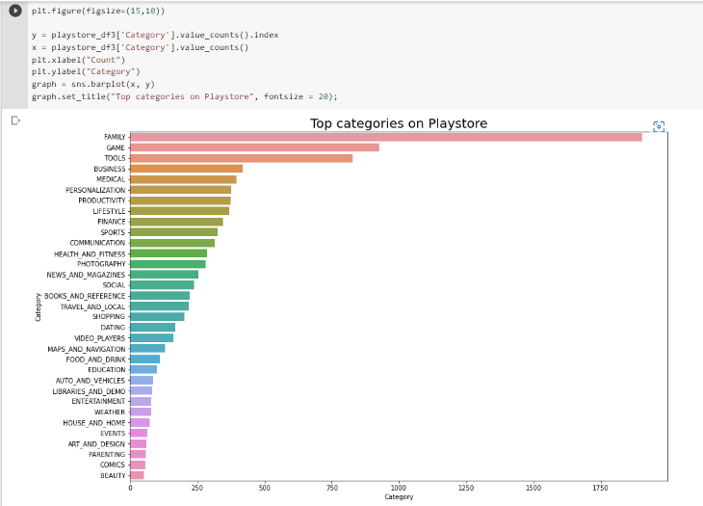
2. Top Categories in Play store
Helpful in identifying the common categories of app
Able to find the least number of apps available category wise
Each categories' contribution

Slide 33
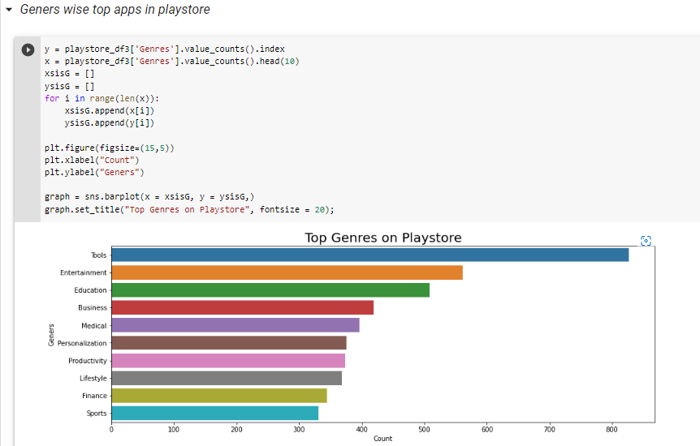
3. Top 10 Genres in Play store
Helpful in identifying top 10 genres in play store
Most Contributed genre

Slide 34
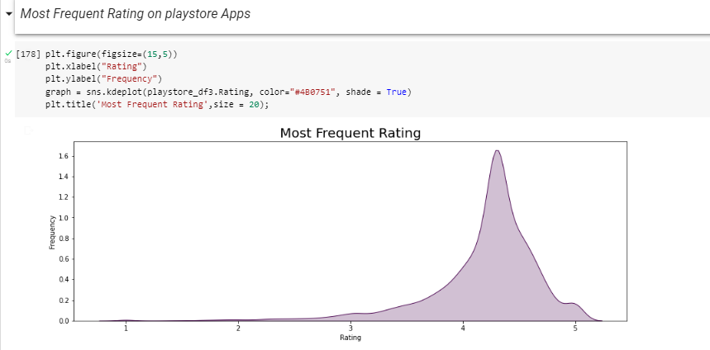
4. Most Frequent Rating on play store Apps
Most app have received rating of approx 4.3

Slide 35
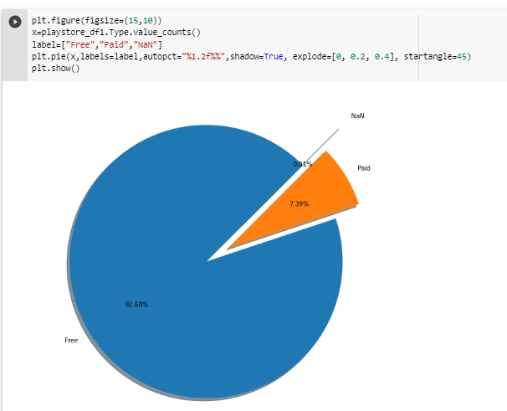
5.Paid and Free Apps Ratio Across play store
Nan value in type column are 0.01%
Free apps in playstore are 92.60%
Paid apps in playstore are 7.39%

Slide 36
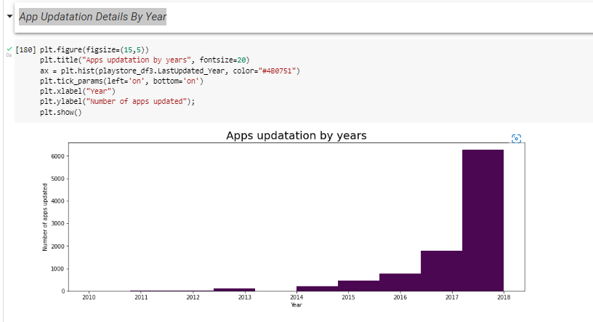
6.App Update Details ‘By Year’
1.Very wide range of app updated in play store during 2017-18

Slide 37
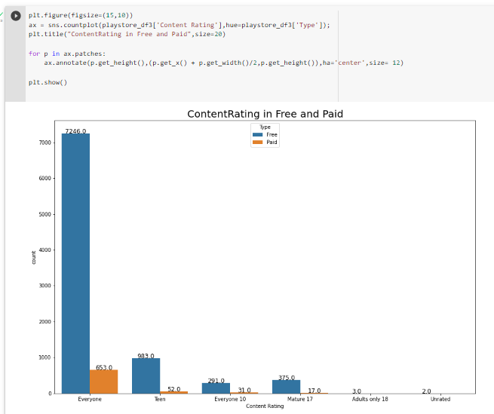
7. Age Wise Free & Paid Apps User’s Detail
After ‘Everyone’ , ‘Teen’ are the max no. of user of the paid and free apps

Slide 38
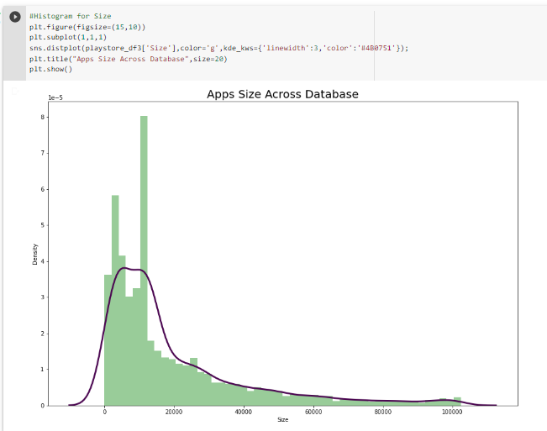
8. Apps Size Across Database
0-20MB size apps are most in play store

Slide 39
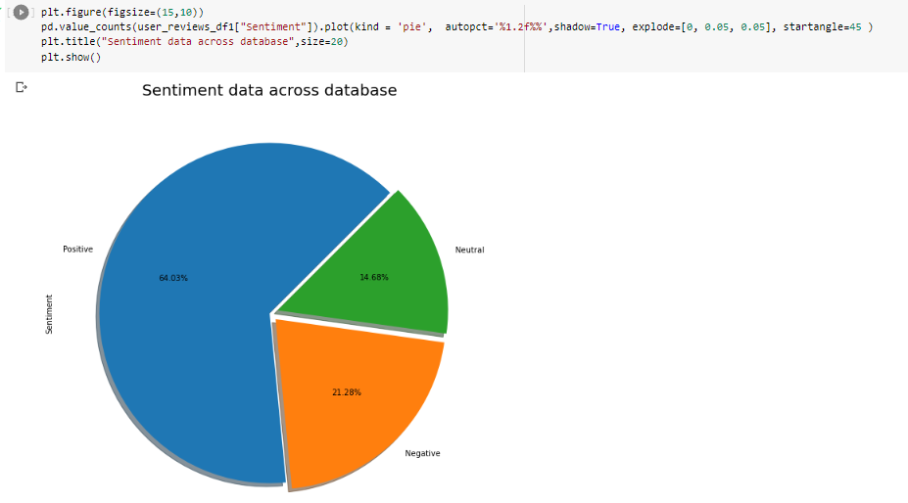
9. Sentiment Data Across the All Reviews

Slide 40
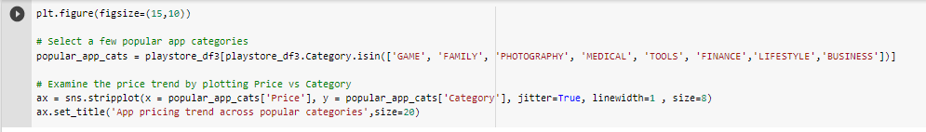
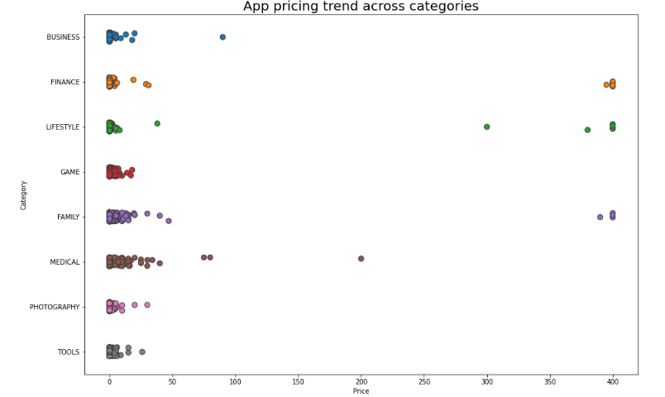
10. App Pricing Trend Across Popular Categories

Slide 41
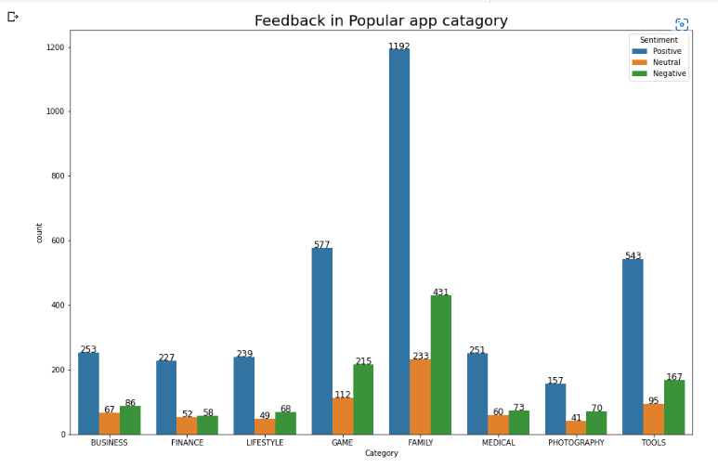
11. Feedback in Popular app catagory

Slide 42
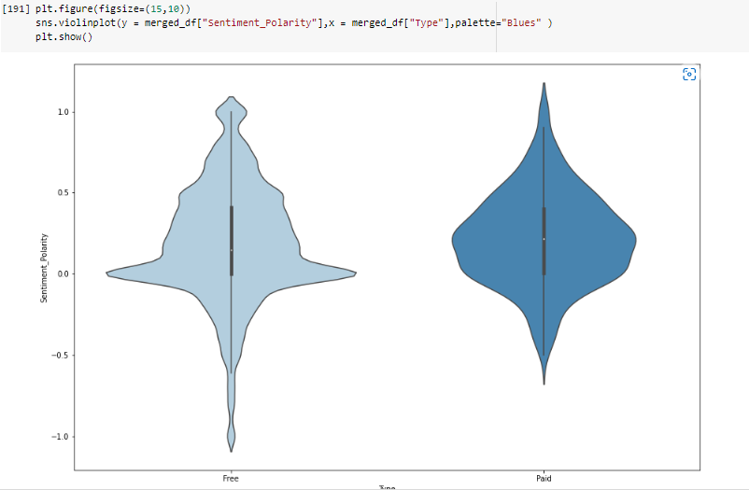
12. Sentiment_Polarity relation with paid and Free App

Slide 43
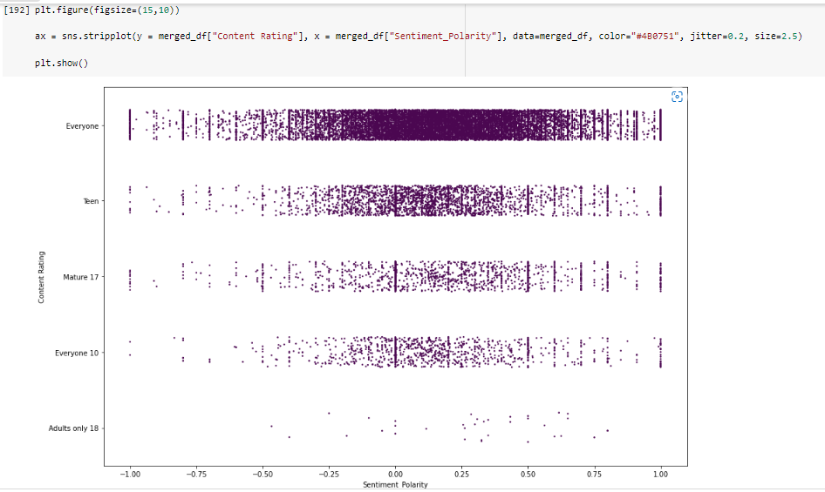
13. Content Rating Relation with Sebtiment Polarity

Slide 44
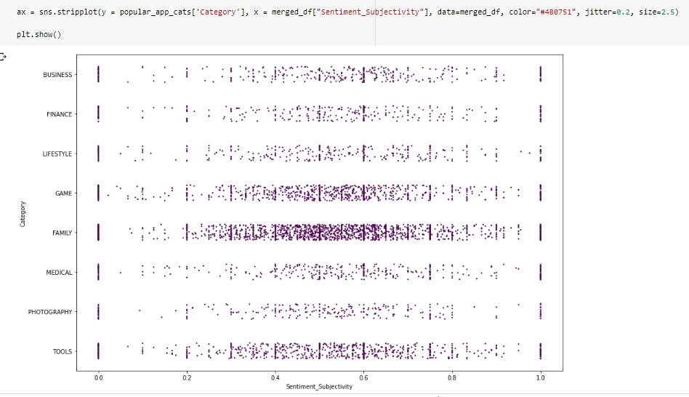
14.Categories Relation with Sentiment_Subjectivity

Slide 45
Conclusions
Most Apps(~65%) are compatible with android version 4.0 or above.
Family , Games and Tools are the top 3 categories of in the given dataset.
Tools, Entertainment, Education related genres have maximum number of apps among all 119 genres.
4.3 rating is the most rating that the apps get .
Free Apps are approx. 93% compared to 7% Paid apps.
Most of the apps (around 6k) were updated in the year 2018.
Content Rating ‘Everyone’ belongs to almost 90% of the Apps followed by the ‘Teens’.
Apps with size range 0-20mb have the highest share.
64% of the apps has positive sentiment.
Most of the paid apps has a price range under $100.

